Slide 1
Advanced Database Management Systems (CSC-234)
Introduction to NoSQL

Slide 2

SQL Systems

Slide 3
NoSQL

Slide 4
ACID: Atomicity
Guarantee that either all of the transaction succeeds or none of it does
E.g., transferring from checking account into saving account
Complete all steps as a single indivisible unit or complete none of them

Slide 5
ACID: Consistency
Strict consistency required in relational databases
A transaction does not leave the database in a state that violates the integrity of the data

Slide 6
ACID: Consistency
Transferring $100 from your savings account to your checking account must end with either
(a) $100 more in your checking account and $100 less in your savings account or
(b) both accounts have the same amount as they had at the start of the transaction
Consistency ensures no other possible state could result after a transfer operation

Slide 7
ACID: Isolation
Guarantees that all transactions will occur in isolation
No transaction will be affected by any other transaction

Slide 8
ACID: Durability
This means that once a transaction or operation is completed, it will remain even in the event of a power loss
In effect, this means that data is stored on disk, flash, or other persistent media

Slide 9
Relational database management systems are designed to support ACID transactions. NoSQL databases typically support BASE transactions, although some NoSQL databases also provide some level of support for ACID transactions.

Slide 10
BASE: Basically Available
There can be a partial failure in some parts of the distributed system and the rest of the system continues to function
For example, if a NoSQL database is running on 10 servers without replicating data and one of the servers fails, then 10% of the users’ queries would fail, but 90% would succeed
NoSQL databases often keep multiple copies of data on different servers. This allows the database to respond to queries even if one of the servers has failed.

Slide 11
BASE: Soft State
It is okay for data to be eventually be over-written by more recent data

Slide 12
BASE: Eventually Consistent
There may be times when the database is in an inconsistent state
E.g., multiple copies exist but there can be situations in which they are not consistent for short periods of time

Slide 13
Four Types of NoSQL Systems
Key-value pair databases
Document databases
Column family store databases
Graph databases

Slide 14
On distributed systems
It’s not necessary for noSQL systems to be distributed
However, some of the most appealing features do require a distributed deployment
When availability and scalability are top concerns distributed deployments make sense

Slide 15
With distributed systems
Decisions and trade-offs required not found in single-server implementations
Balance need for scalability, availability, consistency, partition protection, and durability

Slide 16
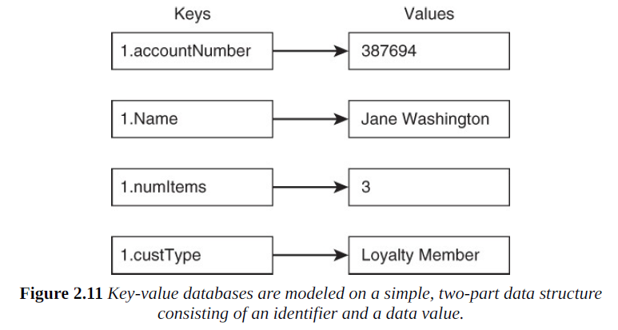
Key-Value Pair Databases
All of these values are associated with a customer, so you can generate a sequential number for each customer. For each item you are storing, you create a new key by appending the name of the item you are storing to the customer number.

Slide 17
Key-Value Pair Databases
Approach works for relatively simple databases

Slide 18
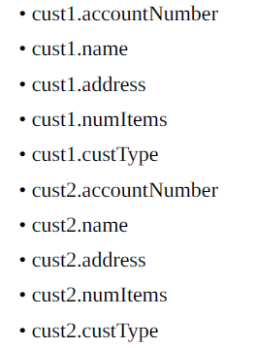
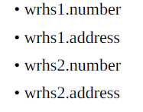
Key-Value Databases
In a database with customer and warehouse information for example, use pre-fixes to avoid clashes

Slide 19
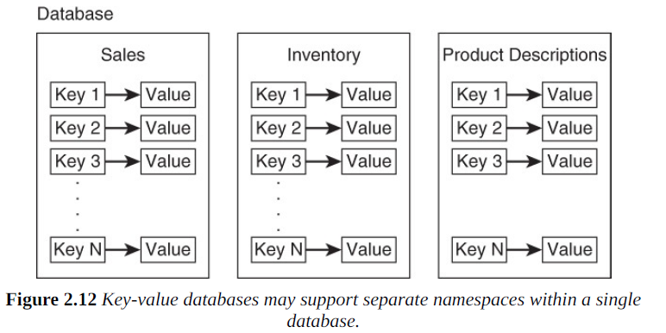
Different Namespaces using Buckets

Slide 20
Values
Values can range from strings and numbers to images and binary objects

Slide 21
Key Values vs. Relational
Key-values based on minimal principles for storing and retrieving data
No tables, no columns, no keys, no joins …
No powerful query mechanism like SQL

Slide 22
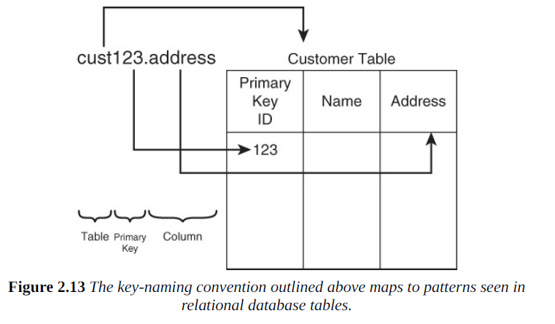
Key Values vs. Relational

Slide 23
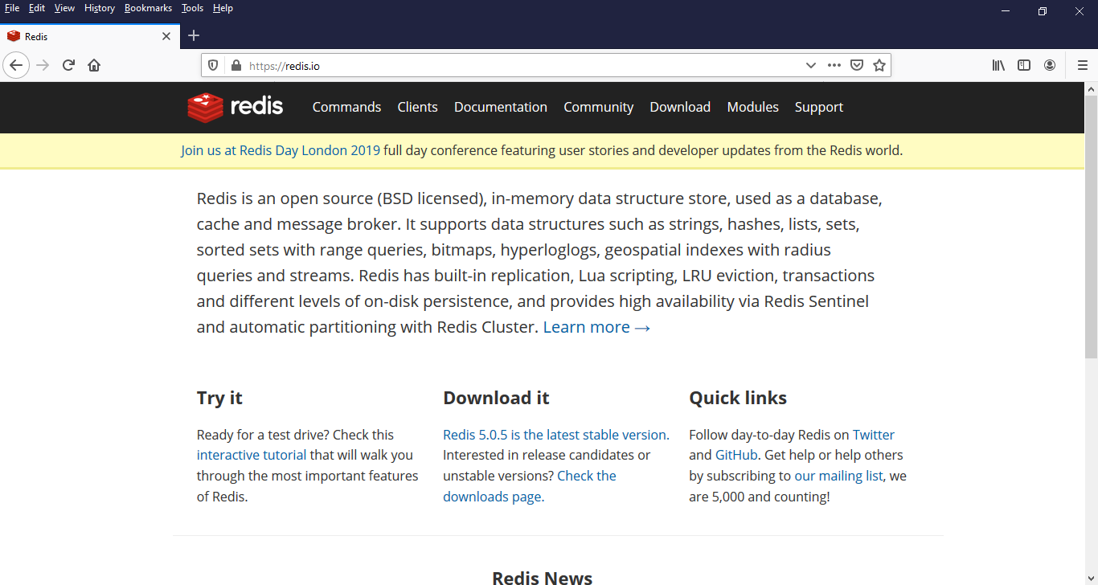

Slide 24
Document Databases
Uses a key value approach but stores documents as values
Documents are semi-structured entities in standard formats such as
JSON (JavaScript Extended Object Notation)
XML (Extensible Markup Language)

Slide 25
Documents
Instead of storing each attribute with a separate key, document databases hold multiple attributes in a single document

Slide 26
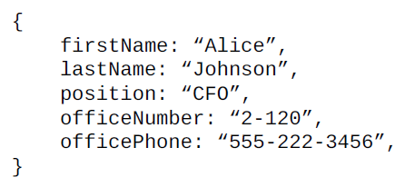
Document in JSON Format

Slide 27
Document Databases
Fixed schema is not required before you can begin adding data to the database
Simply adding a document to the database creates the underlying data structures needed to support the document
Therefore, there is more flexibility

Slide 28
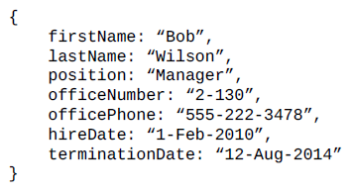
Two valid entries in the same document database.

Slide 29
Software applications will however be responsible for handling these discrepancies

Slide 30

Querying

Slide 31
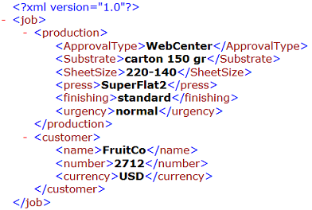
XML Format

Slide 32
Document vs. Relational
Document doesn’t require pre-defined schema
Documents have embedding
Do support querying for multiple attributes like SQL

Slide 33
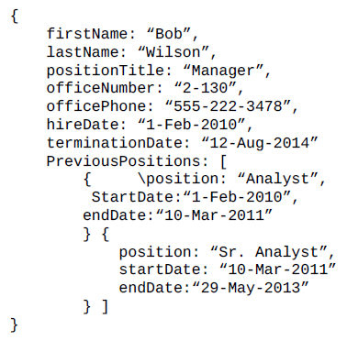

Slide 34
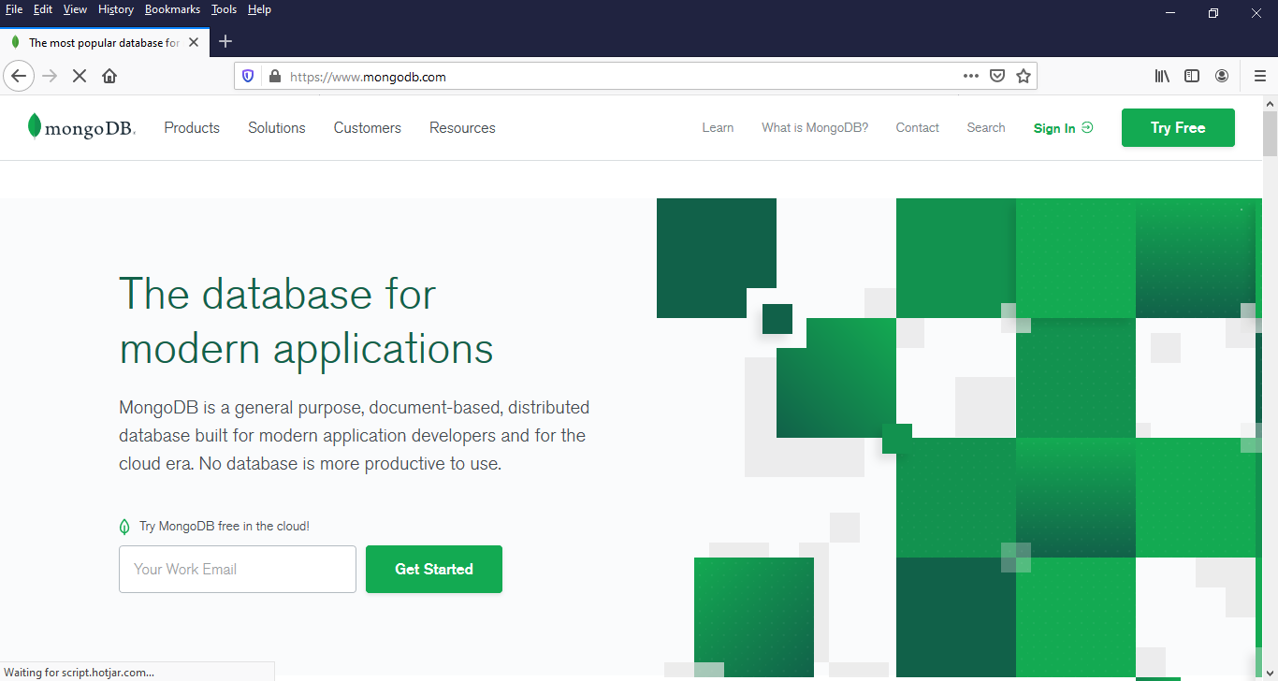

Slide 35
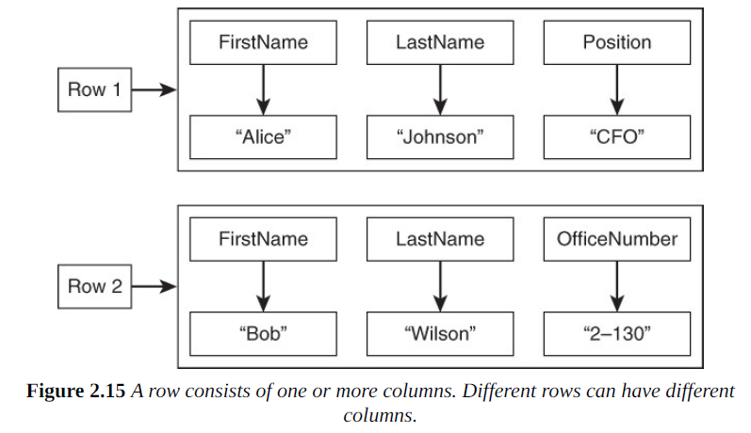
Column Family Databases

Slide 36
Column Family Databases
Superficially similar to RDBMS
Query languages look similar except there are no joins
Unlike RDBMS, sets of columns in a family can vary
Column DBs are denormalized or structures so that all information is available in one single row
Primary benefit is that some queries can become extremely fast

Slide 37
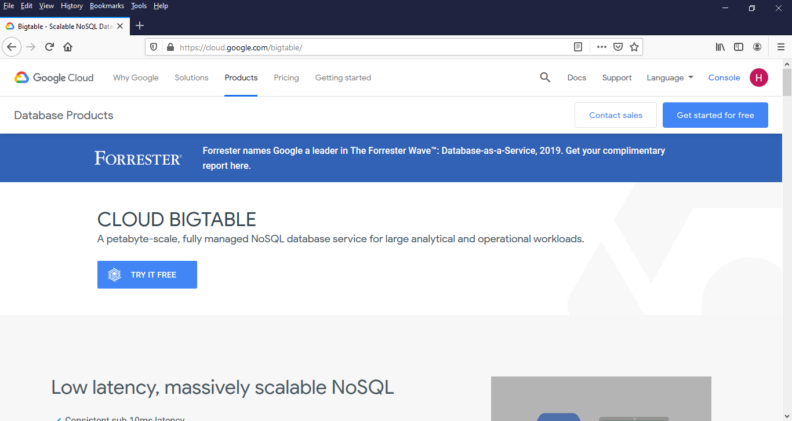

Slide 38
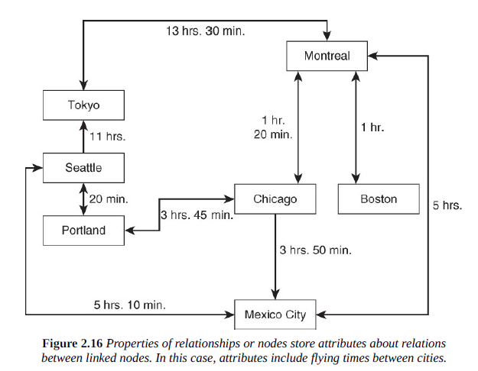
Graph Databases

Slide 39
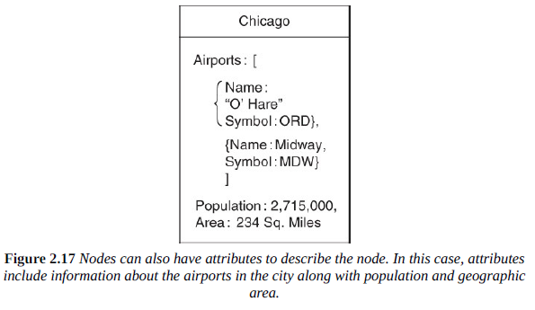

Slide 40
Graph Databases vs. Relational
Graph databases are designed to model adjacency between objects
Every node in the database contains pointers to adjacent objects in the database
This allows for fast operations that require following paths through a graph

Slide 41
Find fastest route from Montreal to Mexico City

Slide 42
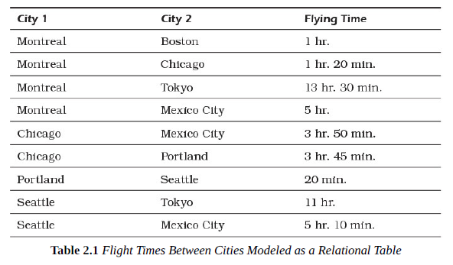
Now do the same with this RDBMS representation

Slide 43
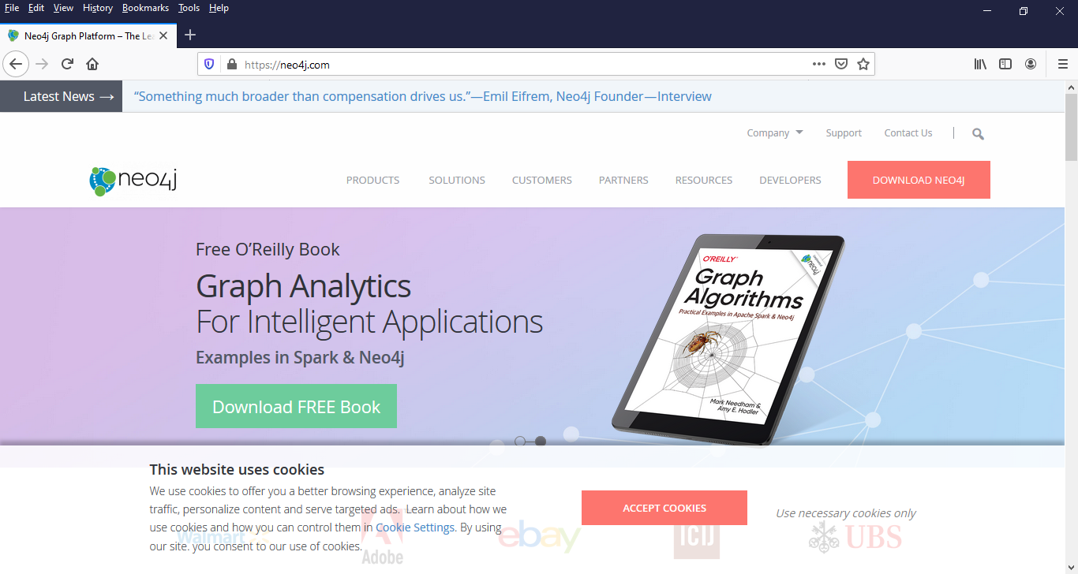

Slide 44
Lecture adapted from chapter 3 of NoSQL for Mere Mortals.

